Slide 1


WP2 –Task 2.4
Acoustic Characterization of dissipative particles
Review Meeting M24, Heraklion, 28/6/19

Slide 2
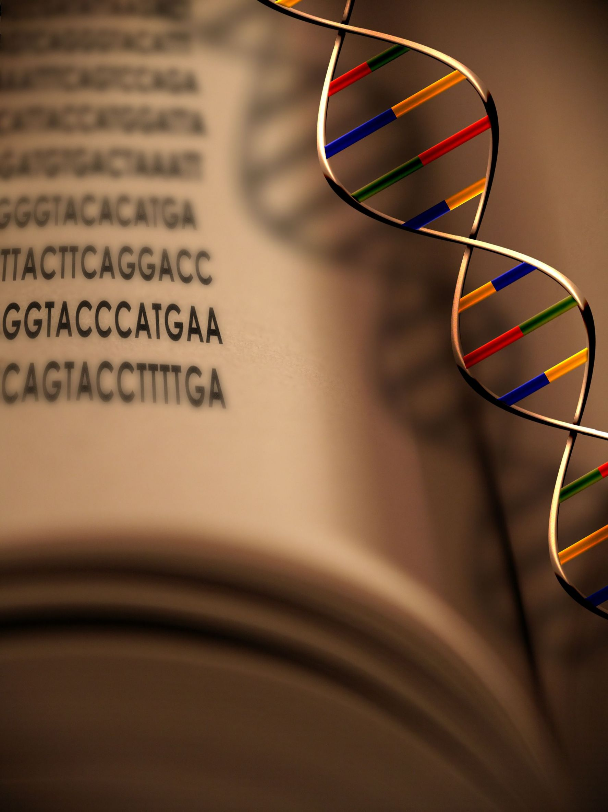
Objective 1:
to increase the Acoustic signal
NAv
DNA
Liposomes
Δf (Hz)
(i)
(ii)
(iii)
Cholesterol
ΔD (10⁻⁶)
time (min)
Review Meeting M24, Heraklion, 28/6/19

Slide 3
Objective 1:
to increase the Acoustic signal
Surface
decoration
Mechanical
Properties
Encapsulation
PEGs
~ 5 nm
Melting Temperature
(T_{m})
Leakage
Problems
Non-Specific
Signal
Review Meeting M24, Heraklion, 28/6/19

Slide 4
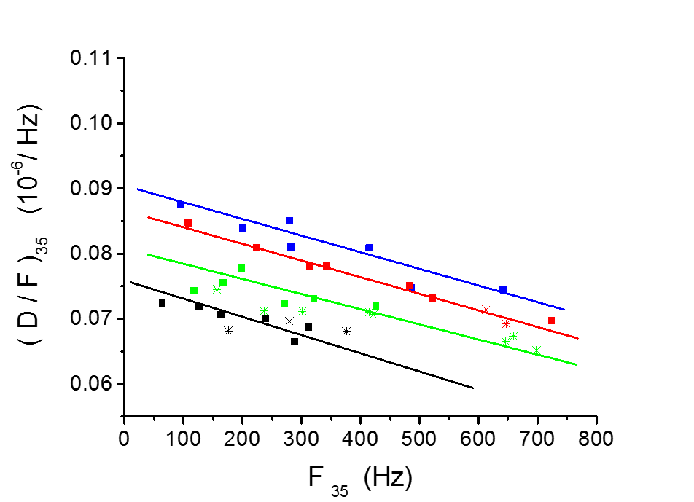
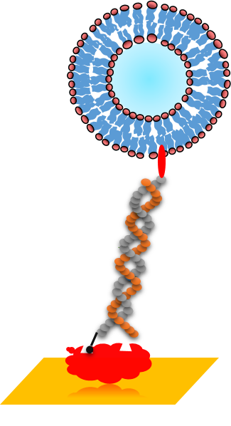
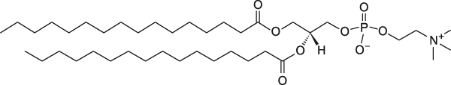
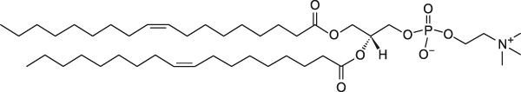
Objective 1:
(M1-M12)
“Mixed” Particles (DOPC:DPPC)
100 % ???
% DPPC
70 %
50 %
0 %
30 %
DPPC = +41 °C
DOPC = -17 ºC
PROBLEM: Difficult to prepare DPPC 100 %
Review Meeting M24, Heraklion, 28/6/19

Slide 5
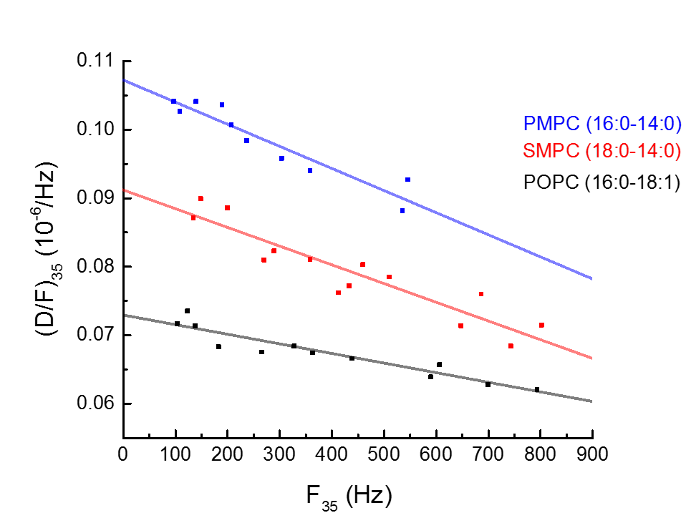
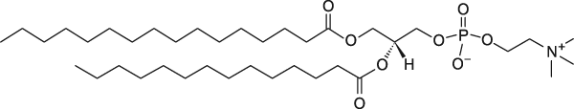
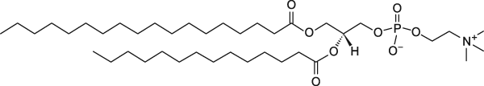
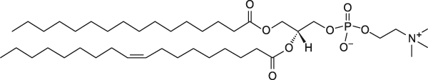
Objective 1:
(M12-M24)
“Pure” Particles
Mechanical
Properties
PMPC = 27 ºC
SMPC = 30 °C
Solution:
Lipid Lower Tm
POPC = -2 °C
Review Meeting M24, Heraklion, 28/6/19

Slide 6
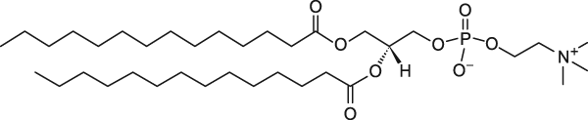
Objective 1:
(M12-M24)
vs Temperature
Mechanical
Properties
DMPC = 23 ºC
Na
Solution:
Same Lipid vs Temperature
Review Meeting M24, Heraklion, 28/6/19

Slide 7
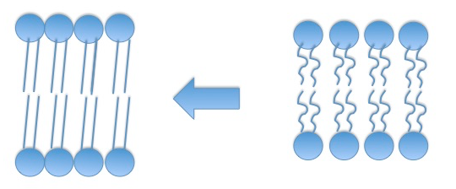
Objective 1:
(M12-M24)
“Gel”
phase
“Liquid”
phase
Rigid/Solid
Soft/Fluid
(M1-M12): “Mixed” Particles (DOPC:DPPC)
(M12-M24): “Pure” Particles
(M12-M24): vs Temperature
“Gel” Phase of lipids is more dissipative
Review Meeting M24, Heraklion, 28/6/19

Slide 8
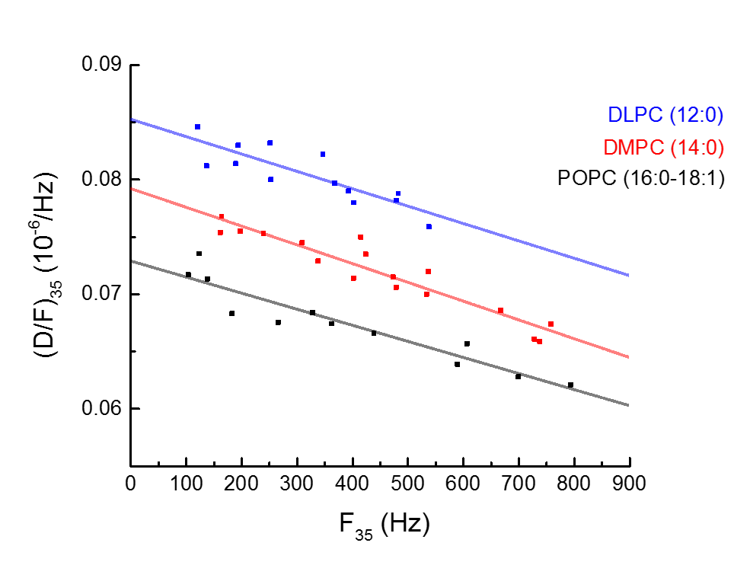
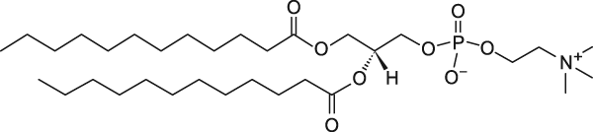
Objective 1:
(M12-M24)
Fatty Acid Length
Membrane
Thickness
Δh
DLPC 3.2 nm*
DMPC
*Neutron Scattering
Kucerka et al
BBA Biomembranes 2011
POPC 3.9 nm*
Review Meeting M24, Heraklion, 28/6/19

Slide 9
Objective 1:
(M12-M24)
Acoustic characterization of
dissipative particles
Surface Linker
“Tight”/Rigid (NAv on gold)
bBSA + NAv
“Suspended”/Soft (NAv on biotinylated BSA on gold)
POPC 3.9 nm
POPC = -2 °C
Softer Linker is slightly more dissipative
Review Meeting M24, Heraklion, 28/6/19

Slide 10
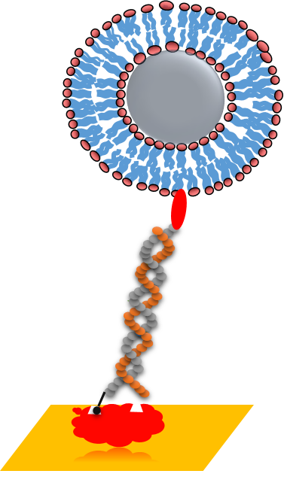
Objective 1:
(M12-M24)
Acoustic characterization of
new dissipative particles
Silica NPs functionalized with supported lipid bilayers (BGU)
SLBs-NPs
Liposomes
Cholesterol
0 – 5 Hz
400 – 800 Hz
Problem: Particles did not bind cholesterylated DNA
Review Meeting M24, Heraklion, 28/6/19

Slide 11
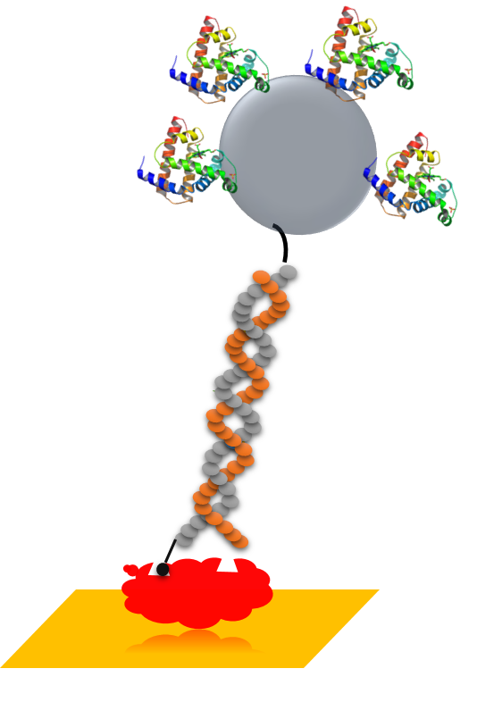
Objective 1:
(M12-M24)
Acoustic characterization of
new dissipative particles
Streptavidin
coated beads
Solid core particles are more dissipative
Review Meeting M24, Heraklion, 28/6/19

Slide 12
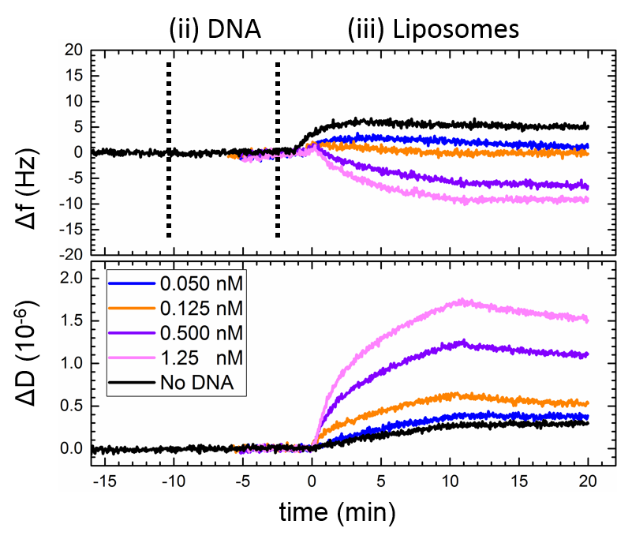
Objective 2
to lower down the Limit of detection (LOD)
Review Meeting M24, Heraklion, 28/6/19

Slide 13



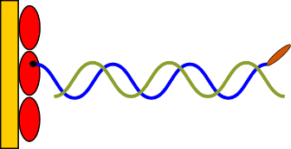
Objective 2
(M12-M24)
to lower down the Limit of detection (LOD)
Limit of Detection (LOD)
Scheme 1 (21 bp, 50 bp and 75 bp)
(1) Capturing
(2) Detection
NAv-Biotin
Cholesterol binding
Review Meeting M24, Heraklion, 28/6/19

Slide 14
Objective 2
(M12-M24)
to lower down the Limit of detection (LOD)
Limit of Detection (LOD)
Scheme 1 (21 bp, 50 bp and 75 bp)
POPC 200 nm
21 bp
50 bp
75 bp
POPC 50 nm
21 bp
50 bp
75 bp
LOD ∼ 2 pM
LOD ∼ 10 pM
200 nm POPC is 5-fold more sensitive than 50 nm
Review Meeting M24, Heraklion, 28/6/19

Slide 15
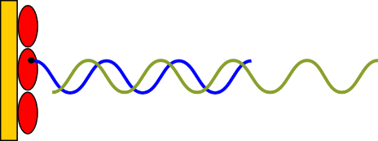
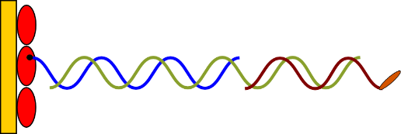
Objective 2
(M12-M24)
to lower down the Limit of detection (LOD)
Limit of Detection (LOD)
Scheme 2 (132 bp)
(1) Capturing
(2a) Hybridization
(2b) Detection
DNA-1
DNA-2
Liposomes
NAv-Biotin
Cholesterol
Cholesterol binding
Review Meeting M24, Heraklion, 28/6/19

Slide 16
Objective 2
(M12-M24)
to lower down the Limit of detection (LOD)
Limit of Detection (LOD)
Scheme 2 (132 bp)
POPC 200 nm
LOD ∼2 pM
LOD ∼2 pM
132 bp is equivalent to 21, 50 and 75 bp
Review Meeting M24, Heraklion, 28/6/19

Slide 17
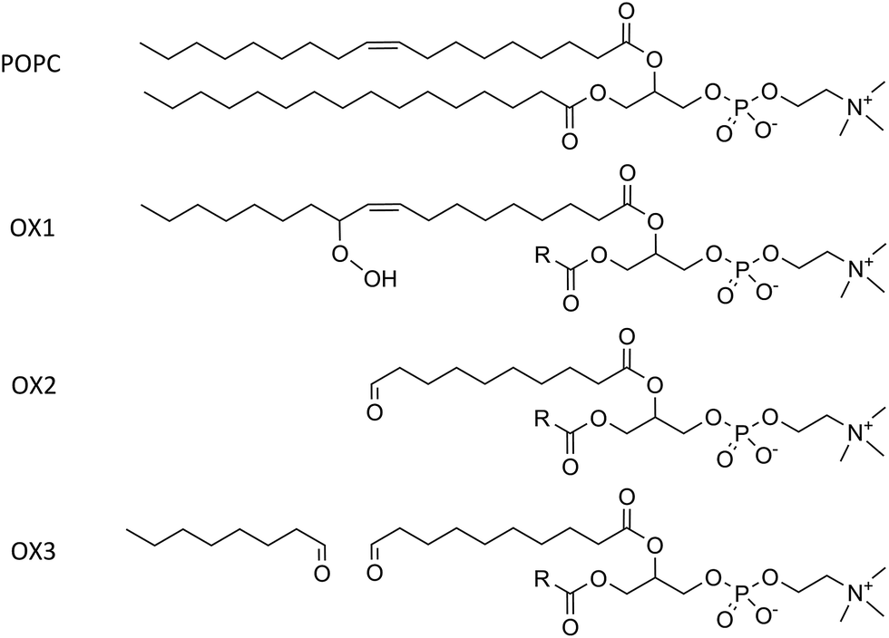
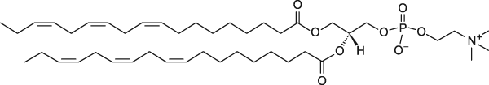
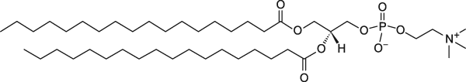
Summary:
Lipids (Tested M1-M12)
“Pure” Soft Particles
“Mixed” Rigid Particles
18:3
18:1
16:0 / 18:1
16:0
18:0
DLPC
( T_{m} ) - 60 ºC
DOPC
- 17 °C
POPC
- 2 °C
DPPC
+ 41 °C
DSPC
+ 55 °C
Review Meeting M24, Heraklion, 28/6/19

Slide 18
Summary:
Lipids (Tested M12-M24)
“Pure” SoftParticles
vs Membrane Thickness
“Pure” Rigid Particles
12:0
14:0
16:0 / 18:1
16:0-14:0
18:0-14:0
DLPC 3.2 nm
- 2 ºC
DMPC
+ 23 °C
POPC 3.9 nm
- 2 °C
PMPC
+ 27 °C
SMPC
+ 30 °C
Review Meeting M24, Heraklion, 28/6/19

Slide 19
Summary:
Acoustic Ratio Measurements of liposomes
 | Dissipation Capacity (10⁻⁶/Hz)^{a,b,c}
Phase of Lipid Bilayer “rigid”/solid vs “soft”/fluid | Lipid Mixtures | DOPC:DPPC (100:0) | DOPC:DPPC (70:30) |  | DOPC:DPPC (50:50) |  | DOPC:DPPC (30:70)
 |  | 0.073 ± 0.001 | 0.078 ± 0.001 |  | 0.087 ± 0.001 |  | 0.090 ± 0.002
 | Pure Particles | POPC (“fluid”) |  | SMPC (“solid”) |  | PMPC (“solid”)
 |  | 0.073 ± 0.001 |  | 0.091 ± 0.002 |  | 0.107 ± 0.002
 | Temperature | DMPC at 25 °C (“fluid”) |  |  | DMPC at 16 °C (“solid”)
 |  | 0.079 ± 0.001 |  |  | 0.099 ± 0.001
Bilayer thickness | Fatty Acid Chains | POPC (16:0-18:1) (“fluid”) |  | DMPC (14:0) (“fluid”) |  | DLPC (12:0) (“fluid”)
 |  | 0.073 ± 0.001 |  | 0.079 ± 0.001 |  | 0.085 ± 0.001
Most promising candidates
Review Meeting M24, Heraklion, 28/6/19

Slide 20
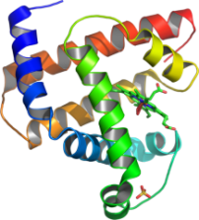
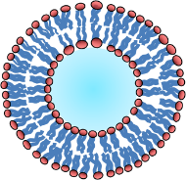
Summary:
Future Plans
SAv
Liposomes
Non-Lipid particles
Ø = 6 nm
Ø = 200 nm
Future work (M-24-M36):
LOD with SMPC, PMPC or DMPC (16 °C)
Ø = 100 nm
Ø = 200 nm
Ø =300 nm
Future work (M-24-M36):
Acoustic ratio and LOD of streptavidin coated particles
- Dendrimers from BGU
Review Meeting M24, Heraklion, 28/6/19

Slide 21
Summary:
--- Problems --- Deviations ---
Not DNA binding to SLBs coated NPs
SLBs coated NPs → SAv coated NPs
Review Meeting M24, Heraklion, 28/6/19

Slide 22
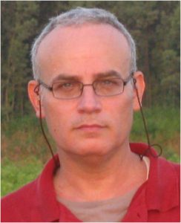

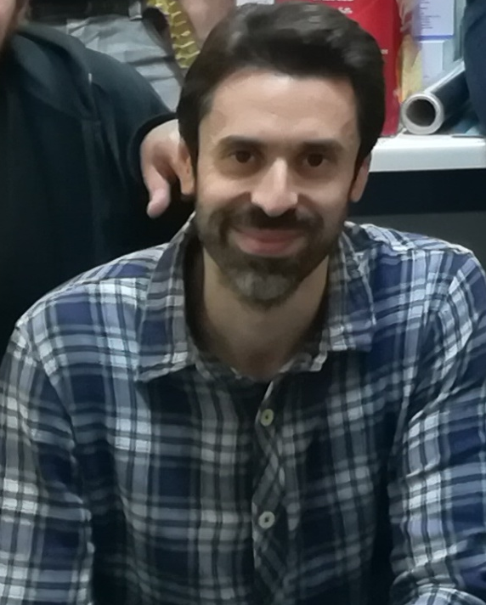

IMBB-FORTH
BGU
Dr. Achilleas Tsortos
Dr. George Papadakis
Prof. Raz Jelinek
- Elad Arad, PhD student
Nikoletta Naoumi, PhD student
THANK YOU
Review Meeting M24, Heraklion, 28/6/19

